Slide 1

Lecture
on
“Advanced Computer Architecture –TCS 704”
by
Akansha Gupta
DEPARTMENT OF COMPUTER SCIENCE AND ENGINEERING
GRAPHIC ERA DEEMED TO BE UNIVERSITY – 248002

Slide 2
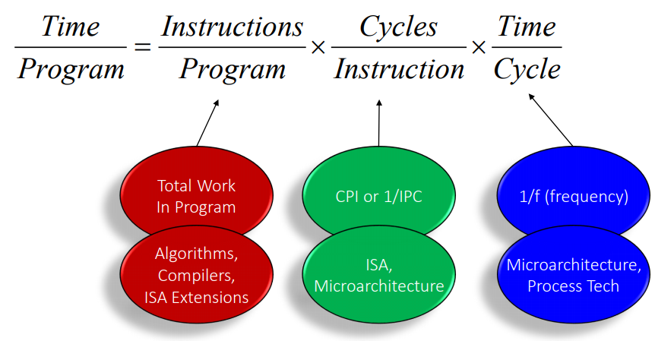

The Iron Law of Processor Performance

Slide 3
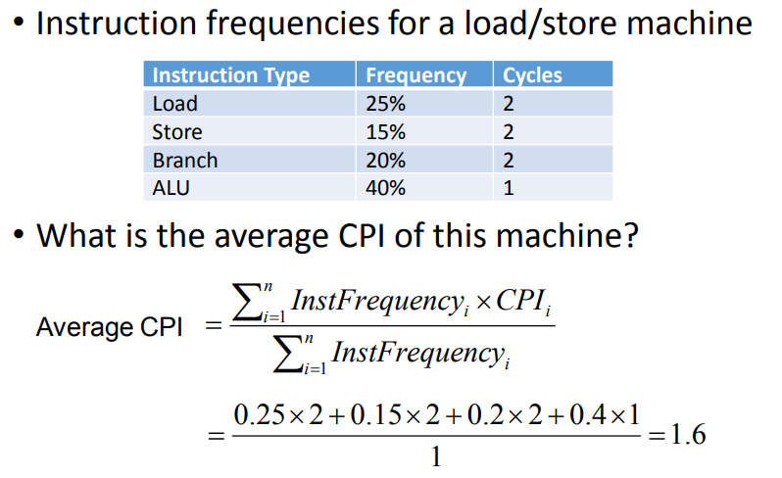
Another View of CPU Performance

Slide 4
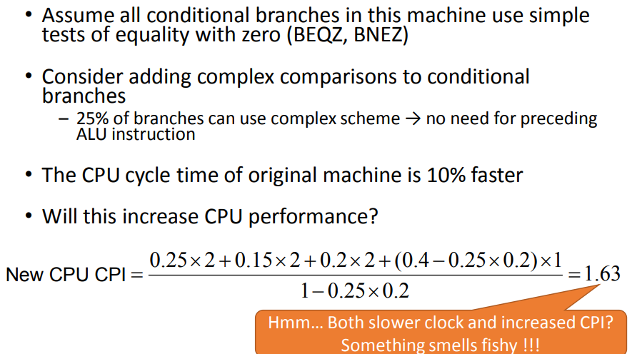
Another View of CPU Performance

Slide 5
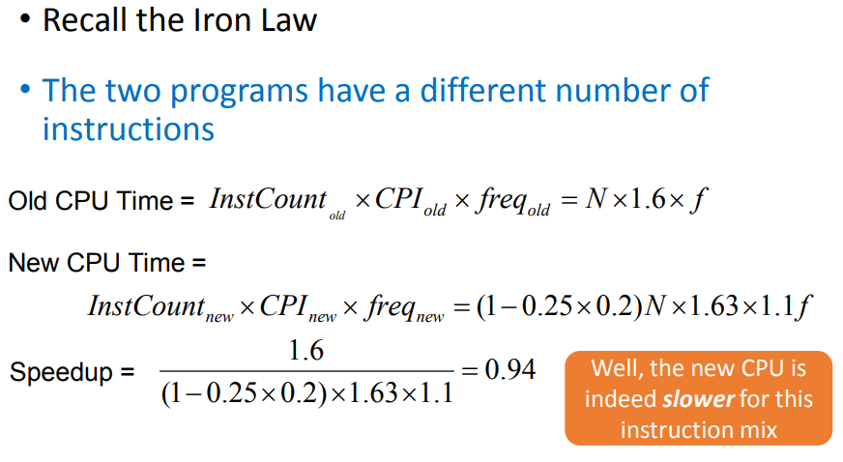
Another View of CPU Performance

Slide 6
Amdahl’s Law Implications
Use Amdahl’s law to determine which design decisions will yield the best system.
Make the Common Case Fast : small improvements for a large percentage of the system are better than large improvements on a small percentage of the system.

Slide 7
Lhadma’s Law
While trying to make the common case fast, do not make the uncommon case worse.
Diminishing Returns
Once the easy changes for improvement have been made, further improvements will not yield great returns. More and more work must be done to obtain small improvements and these improvements will result in small to nearly zero speedups.

Slide 8
UNIT-II
Memory Hierarchy Design:
Basics of Memory Hierarchy,
Coherence and locality properties,
Cache memory organizations,
Cache Performance,
Cache optimization techniques,
Virtual Memory,
Techniques for Fast Address Translation

Slide 9
https://youtu.be/-Sm53y4UYHw
THANKS

